Slide 1

Predicting
Heart Disease
(A Machine Learning Project)

Slide 2
INTRODUCTION
In this presentation, we will explore predicting heart disease using machine learning techniques. We will discuss the importance of early detection and the potential impact on public health.
Understanding Heart Disease To begin, let's delve into the risk factors and symptoms associated with heart disease. Understanding these factors is crucial for accurate prediction and prevention.
Machine Learning Approach This slide will cover the machine learning algorithms and data features used for heart disease prediction. We will explore how these techniques can analyze complex patterns in medical data.
2

Slide 3
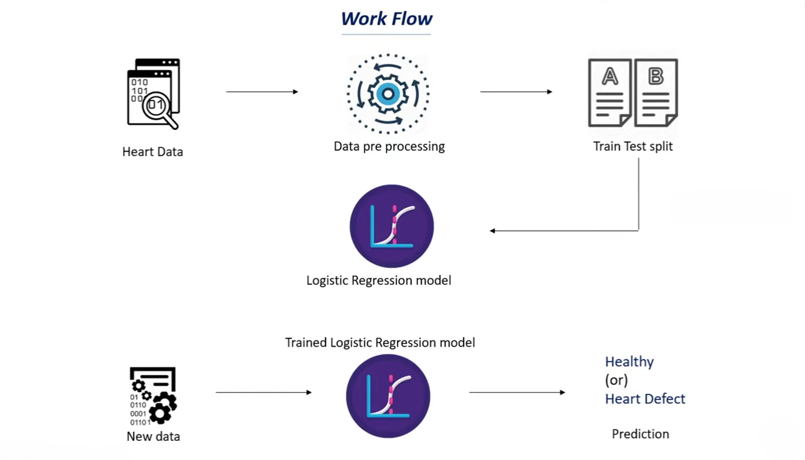

Slide 4
ABOUT DATASET
This data set dates from 1988 and consists of four databases: Cleveland, Hungary, Switzerland, and Long Beach V.
It contains 76 attributes, including the predicted attribute, but all published experiments refer to using a subset of 14 of them.
The "target" field refers to the presence of heart disease in the patient. It is integer valued 0 = no disease and 1 = disease.

Slide 5
KEY ATTRIBUTES
age
sex
chest pain type (4 values)
resting blood pressure
serum cholesterol in mg/dl
fasting blood sugar > 120 mg/dl
resting electrocardiographic results (values 0,1,2)
maximum heart rate achieved
exercise induced angina
oldpeak = ST depression induced by exercise relative to rest
the slope of the peak exercise ST segment
number of major vessels (0-3) colored by fluoroscopy
thal: 0 = normal; 1 = fixed defect; 2 = reversable defect The names and social security numbers of the patients were recently removed from the database, replaced with dummy values

Slide 6
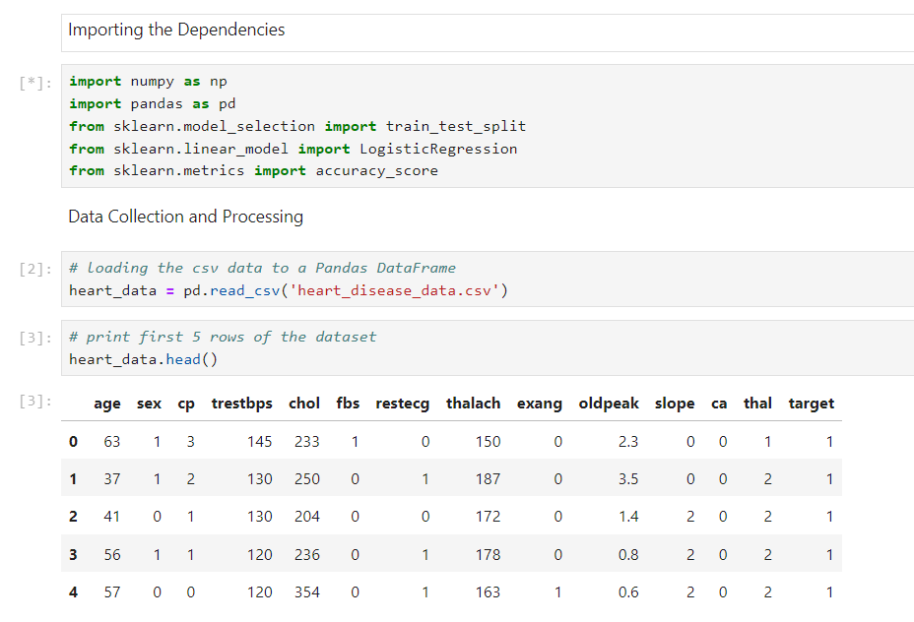

Slide 7
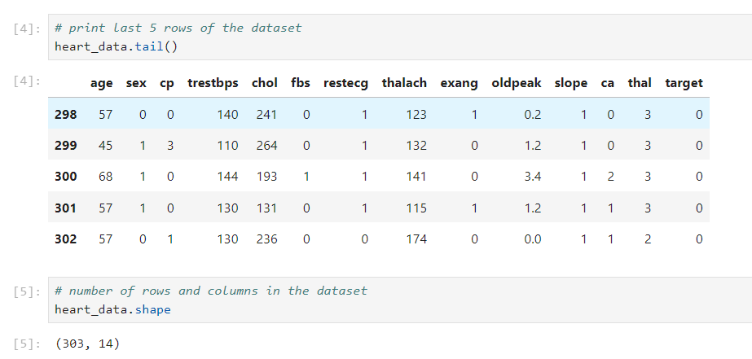

Slide 8
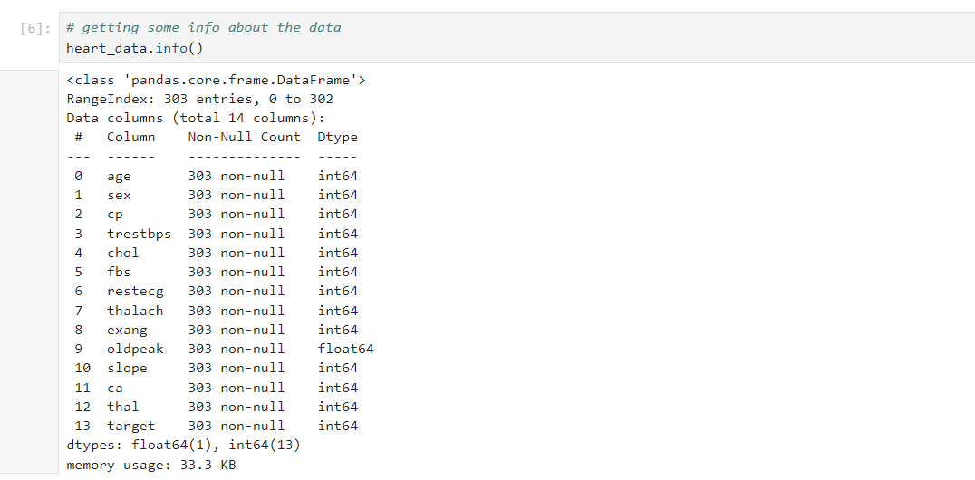

Slide 9
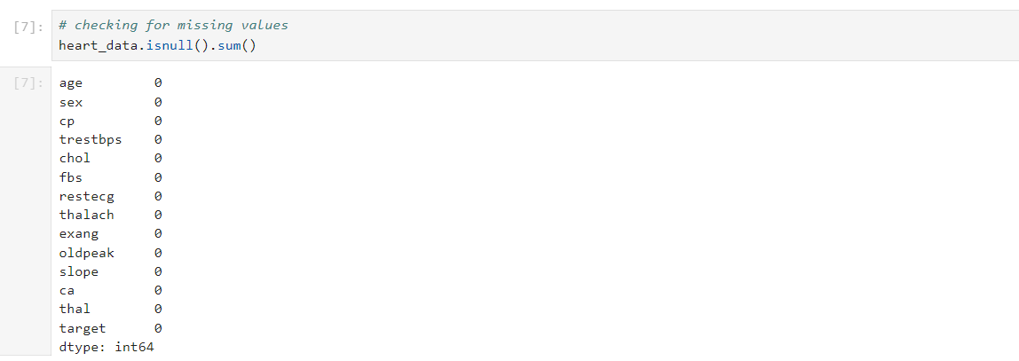

Slide 10
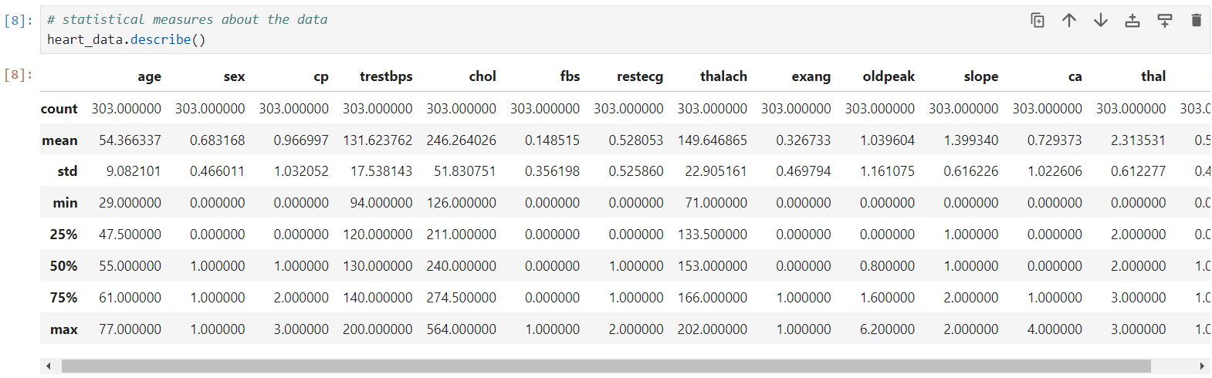
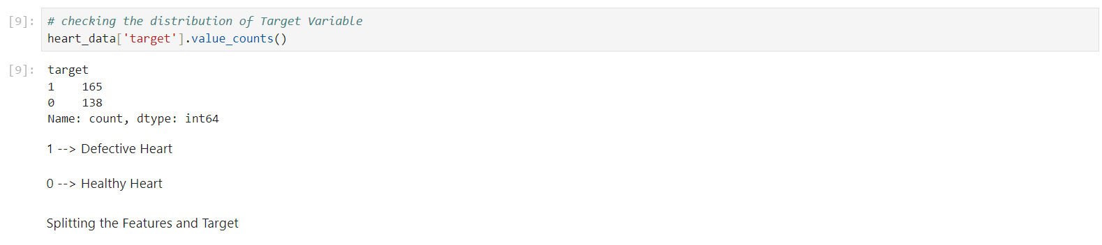

Slide 11
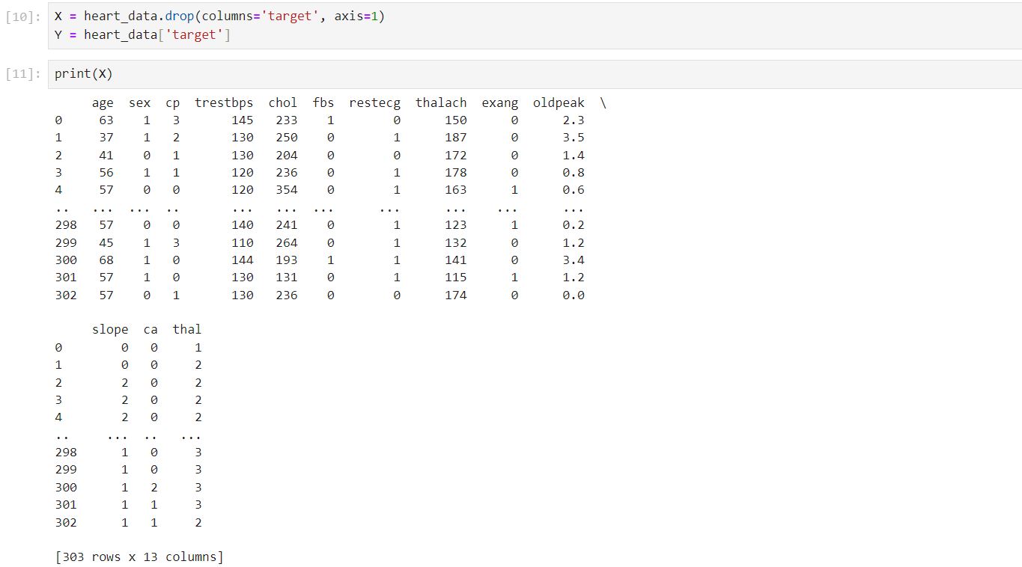

Slide 12
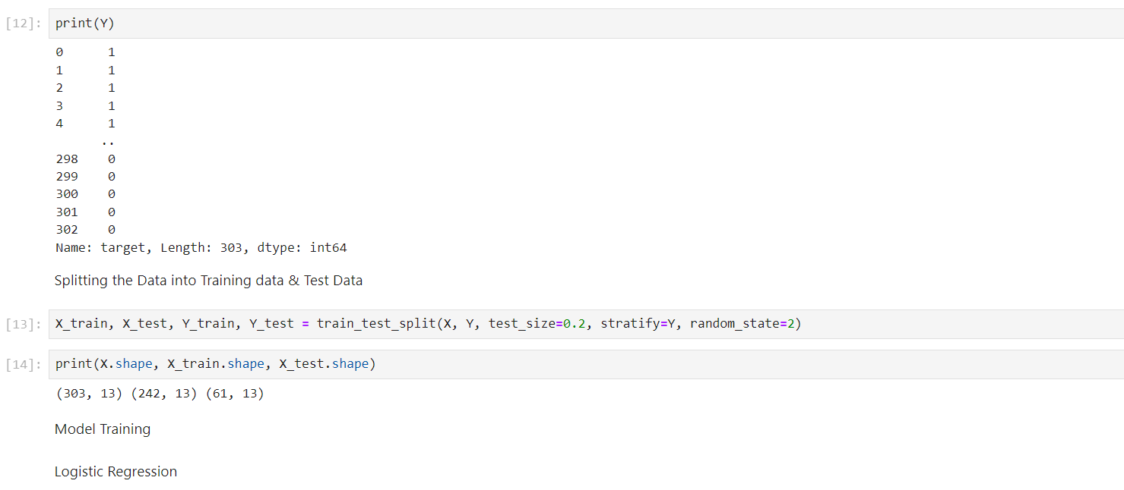

Slide 13
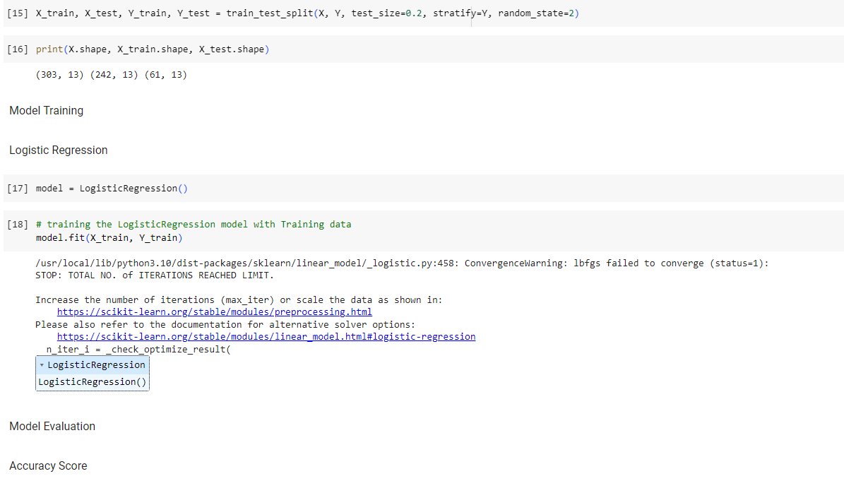

Slide 14
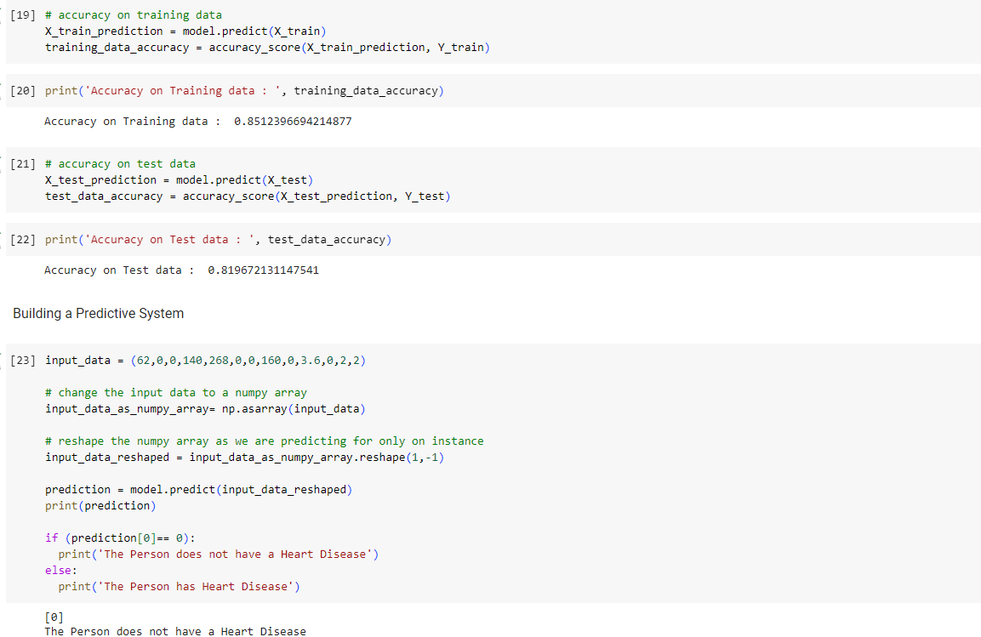

Slide 15
THANK YOU

